Slide 1




2023/2024
DEVIL’S EYE
IS PROJECT
2024
Presented by
MALEK BEN HAMED
ZAKARIA AYADI
ISLEM JERIDI
MARIEM REJEB
TUNIS

Slide 2


Content
INTRODUCTION AND MAIN CONCEPTS EXPLANATION
OVERVIEW OF EXISTING SOLUTIONS
LEVEL DESIGN OF OUR SOLUTION
TOOLS AND DEVELOPMENT PHASES
CODE AND EXECUTABLE VERSION OF OUR SOLUTION

Slide 3

Introduction
A program designed to record and log keystrokes made by the user. Used for monitoring user interactions on electronic devices . It is installed on a target computer and runs in the background, recording every keystroke in applications and password fields. It may also capture screenshots , clipboard activity, and specific applications.
It can be used for both legitimate(parental control) and illegitimate purposes (identity theft)

Slide 4

Main components
Keystroke Capture Module
Data storage module
Transmission module
Activation module
It intercepts and captures keystrokes made by the user as they occur which ensures that the captured data is up-to-date.
Stores the captured keystrokes securely. It ensures data is encrypted to protect it from unauthorized access if the computer is compromised.
Transmits the captured data to a remote location for monitoring and analysis through methods such as emails and file transfer protocols.
It activates the keylogger, allowing it to begin capturing keystrokes and deactivates it by stopping the keylogger from recording activities

Slide 5
Key Solutions for Combating Keyloggers
NO SINGLE DETECTION METHOD IS FOOLPROOF, BUT RISKS CAN BE MINIMIZED.
PROACTIVE MEASURES
Preventive actions to anticipate and prevent potential risk of keylogging attacks, implemented to eliminate vulnerabilities and threats.
REACTIVE MEASURES
Responsive actions to take after a keylogging attack has been detected or suspected to respond effectively and minimize the damage.

Slide 6

01.
Security Software
02.
FIREWALLS
03.
2-FACTOR AUTHENTICATION
A program that offers a combination of techniques to detect, prevent, and remove malicious programs.
They can detect unusual patterns or connections that might indicate keyloggers transmitting data to external sources.
A security protocol that requires users to provide two distinct forms of identification before accessing a system or account. This adds an extra layer of protection.
04.
ANTI-KEYLOGGER SOFTWARE
05.
VIRTUAL KEYBOARDS
06.
SYSTEM UPDATES
Designed to detect and block keylogging threats. It provides targeted features such as keystroke encryption and real-time detection of suspicious activity associated with keylogging software.
A virtual keyboard is a software program that allows users to input characters using graphical representations of keys displayed on a screen
Regular updates including operating system and software updates provide ongoing protection against emerging threats and sophisticated keylogging techniques.
07.
PASSWORD MANAGER
Proactive measures
Software applications designed to securely store and manage users' login credentials for multiple online accounts

Slide 7
01.
DISCONNECT
02.
SCAN
03.
CHANGE CREDENTIALS
Prevents further transmission of data by the keylogger minimizing the risk of additional information theft.
Run a full system scan using an antivirus program to effectively detect and eliminate the threat. Once malware is detected, follow the software’s instructions for removal.
Change all passwords for critical accounts. Use strong, unique passwords for each account and consider using a password manager to securely store complex passwords.
04.
MONITOR
05.
REPORT INCIDENT
06.
UPDATE
Regularly review your bank statements and credit card reports for any suspicious activity.
Report keylogger infection to cybersecurity organizations which contributes to tracking these threats.
Keeping security software up-to-date and implementing additional security measures enhances overall protection .
07.
BACKUP DATA
Backing up critical data ensures data integrity and availability in the event of a keylogging attack or other cybersecurity incidents.
Reactive measures

Slide 8
Keylogger Design and Operations
THE STRUCTURAL ELEMENTS, THE SYSTEM DESIGN AND THE FUNCTIONS PROVIDES A COMPREHENSIVE OVERVIEW OF ITS ARCHITECTURE AND THE VARIOUS ACTIONS PERFORMED.
KEYLOGGER OPERATIONS
KEYLOGGER DESIGN
structural elements depicted in use case and class diagrams, detailing how keyloggers are configured and managed.
practical guide, detailing how keyloggers interact with and handle sensitive data.

Slide 9
01.
User Roles
End Users
(Victims)
Administrators
Attackers
Victims unknowingly subjected to surveillance or monitoring through the use of keylogging software, exposing sensitive data. These users unwittingly have their keystrokes and digital activities monitored by this malicious software.
Configure and manage keylogger software for legitimate purposes such as within organizational domains, or parental control.
malicious actors who aim to compromise the security and privacy of end users and organizations by deploying keylogging software for nefarious purposes.
Keylogger Design

Slide 10
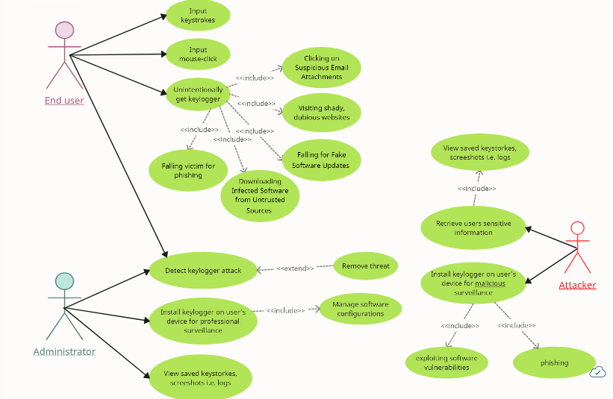
02.
Use Case Diagram

Slide 11
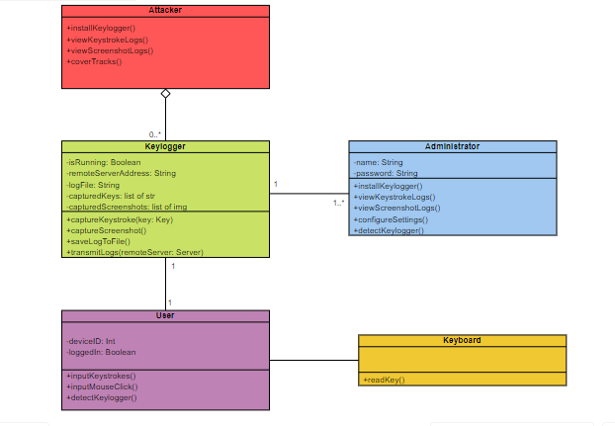
03.
Use Case Diagram
EndUser class: includes methods for inputting keystrokes and mouse clicks.
Administrator class: includes methods for installing the keylogger on user devices for professional surveillance.
Attacker class: includes methods for installing the keylogger on user devices for malicious purposes.
Keylogger class: represents the software responsible for capturing and logging keystrokes on the user’s device.

Slide 12
01.
Keylogger exchanged data
Keystrokes
Mouse Clicks
Screenshots
every key pressed by the user on the keyboard whether it is virtual or not. Keystroke logging enables to capture sensitive information and confidential data entered by the end user.
movements, providing insights into the user’s interactions with graphical user interfaces (GUIs). Mouse click logging can be used to track user activity within applications and web browsers.
screenshots of the user’s desktop at regular intervals or in response to specific events. These screenshots can reveal sensitive information displayed on the screen.
Keylogger Operations

Slide 13
02.
Keylogger functions and steps
KEYSTROKE LOGGER
Capture keystrokes in real-time.
Record keystrokes in a log file.
Operate stealthily to avoid detection.
SCREEN CAPTURE MODULE
Periodically capture and save screenshots.
Timestamp screenshots for chronological organization.
Package and compress captured data.
Transmit data securely over the internet.
Encrypt data to ensure confidentiality.
DATA TRANSMISSION MODULE
REMOTE CONTROL MODULE
Execute commands from a remote attacker.
Handle responses and errors gracefully.

Slide 14
TOOLS AND DEVELOPMENT PHASES
Project goal
Given their ability to secretly record keystrokes and compromise critical data, keyloggers pose a serious danger to cybersecurity. The primary objective of our project is to construct a functional keylogger. By doing so, we seek to gain insights into its mechanisms and behavior, facilitating the development of effective countermeasures against such malicious software.
Scope
Our project involves the creation of a functional keylogger aimed at capturing keystrokes and screen activity covertly. It will encompass the development, testing, and documentation of the keylogger software, focusing on its core functionalities such as keystroke logging, screen capturing, data transmission, concealment techniques, and remote control capabilities. The project's scope extends to conducting thorough analysis and research into keylogging techniques and countermeasures, ensuring ethical and legal compliance throughout the process.

Slide 15
ENVIRONMENT AND TOOLS :
- We will use Visual Studio Code and PyCharm as our IDEs, alternating between these for efficient coding. GitHub will serve as our Version Control System, ensuring code integrity and facilitating teamwork. Python, chosen for its simplicity, will be our primary language, using libraries like pynput for keylogging implementation. The Windows API will help us access Microsoft Windows features, enabling task tracking and progress monitoring throughout development.
DEVELOPMENT PHASES :
1.Planning Phase: Understand keylogger functionality, Meetings, defining scope, setting milestones.
2.Development Phase: Implement keylogger features, Setup environment, coding (Python, LaTeX).
3.Testing Phase: Ensure robustness and functionality, Create test cases, fix bugs and system testing.
4. Deployment Phase: Prepare for presentation, Package software, user testing, deployment.

Slide 16

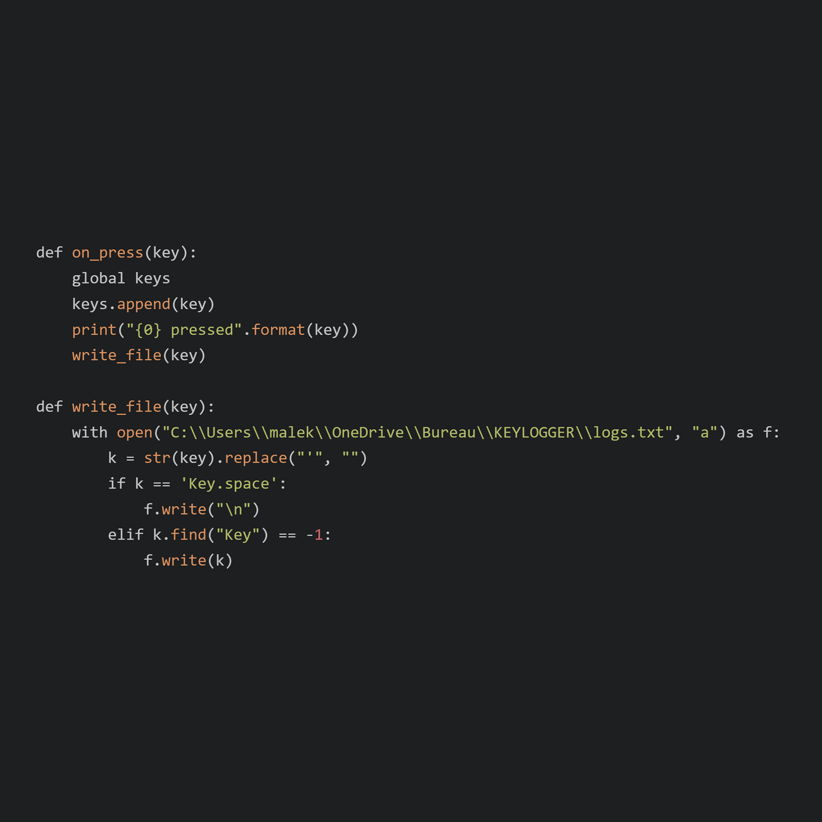

CODE
The on_press function logs each key press by appending it to a list, printing it to the console, and writing it to a file.
The write_file function ensures that each key press is correctly formatted and logged, treating spaces as newlines and ignoring other non-printable keys.

Slide 17
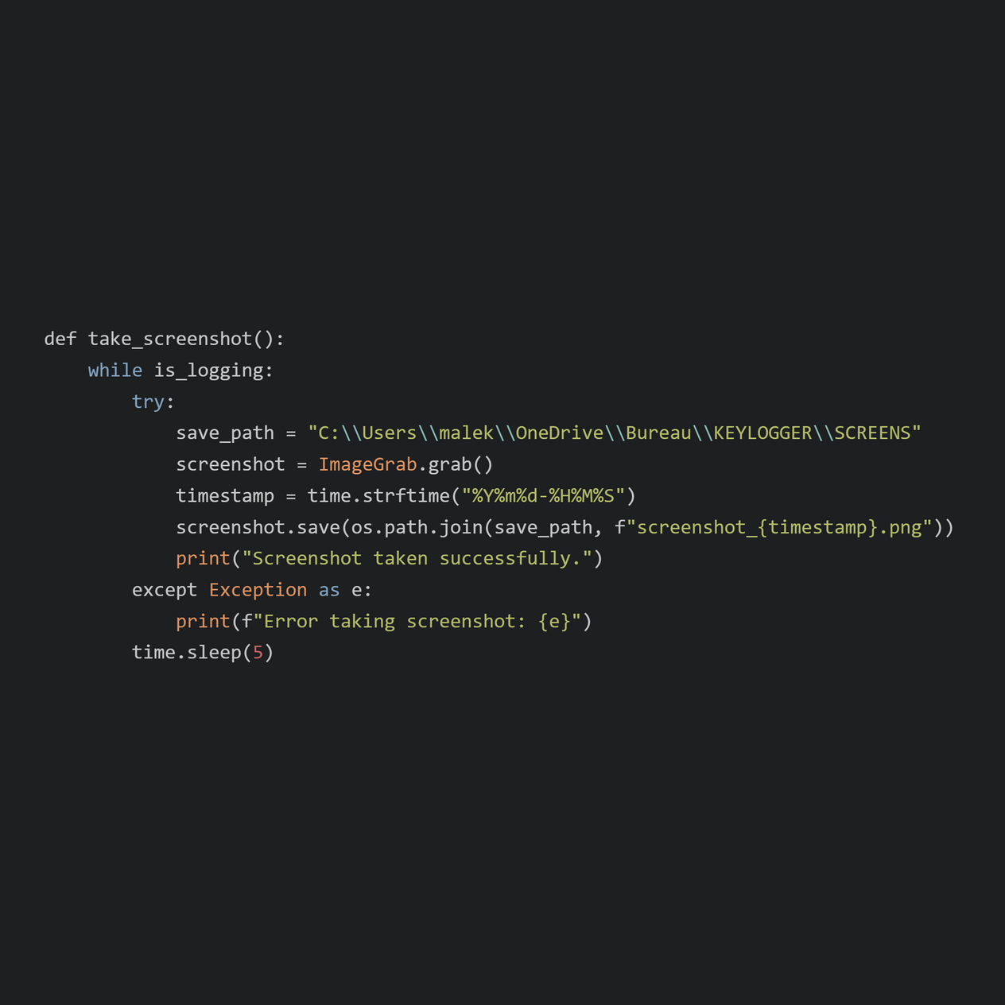
The take_screenshot function continuously takes screenshots at 5-second intervals and saves them to a specified directory as long as is_logging is True.
It handles errors gracefully by catching exceptions and printing error messages.
Each screenshot is saved with a unique timestamped filename to avoid overwriting files.

Slide 18
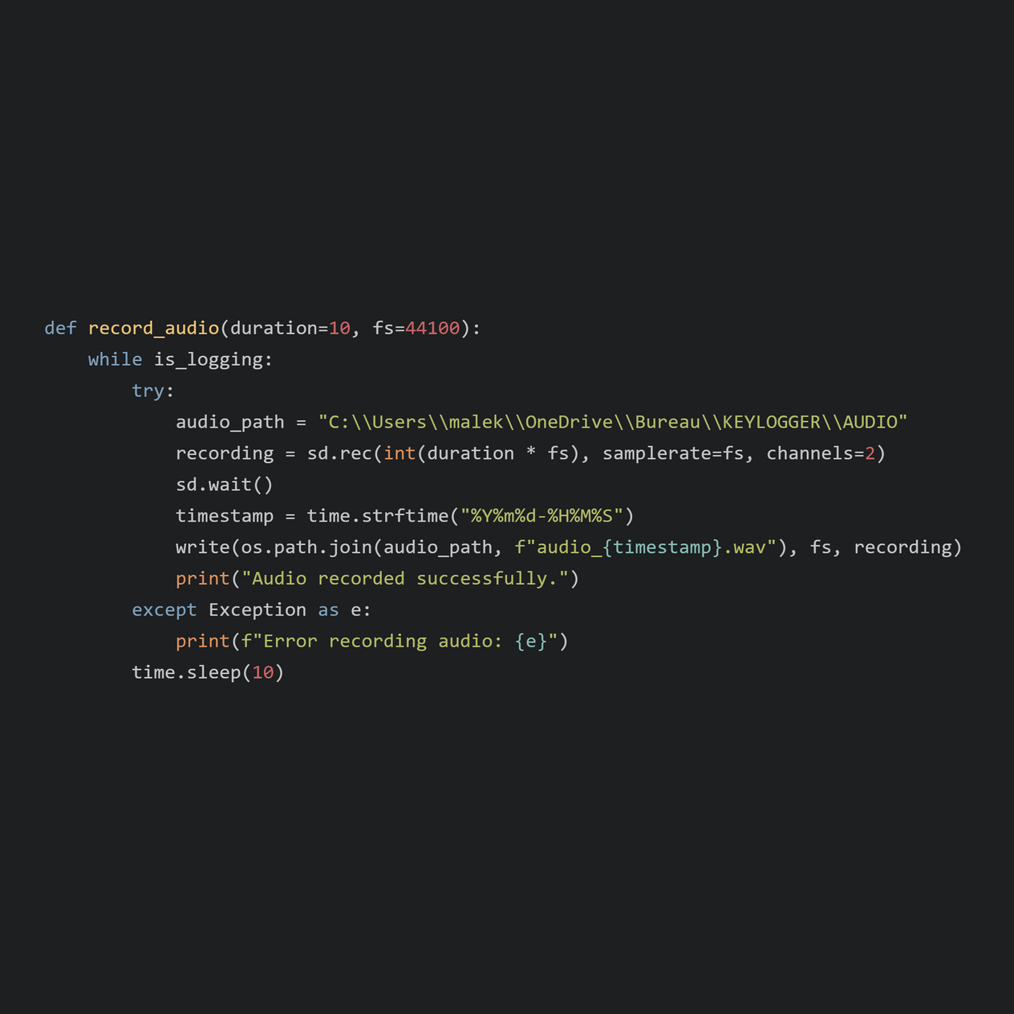
The record_audio function continuously records audio in chunks of the specified duration (default 10 seconds) and saves them to a specified directory as long as is_logging is True.
It handles errors gracefully by catching exceptions and printing error messages.
Each audio recording is saved with a unique timestamped filename to avoid overwriting files.

Slide 19
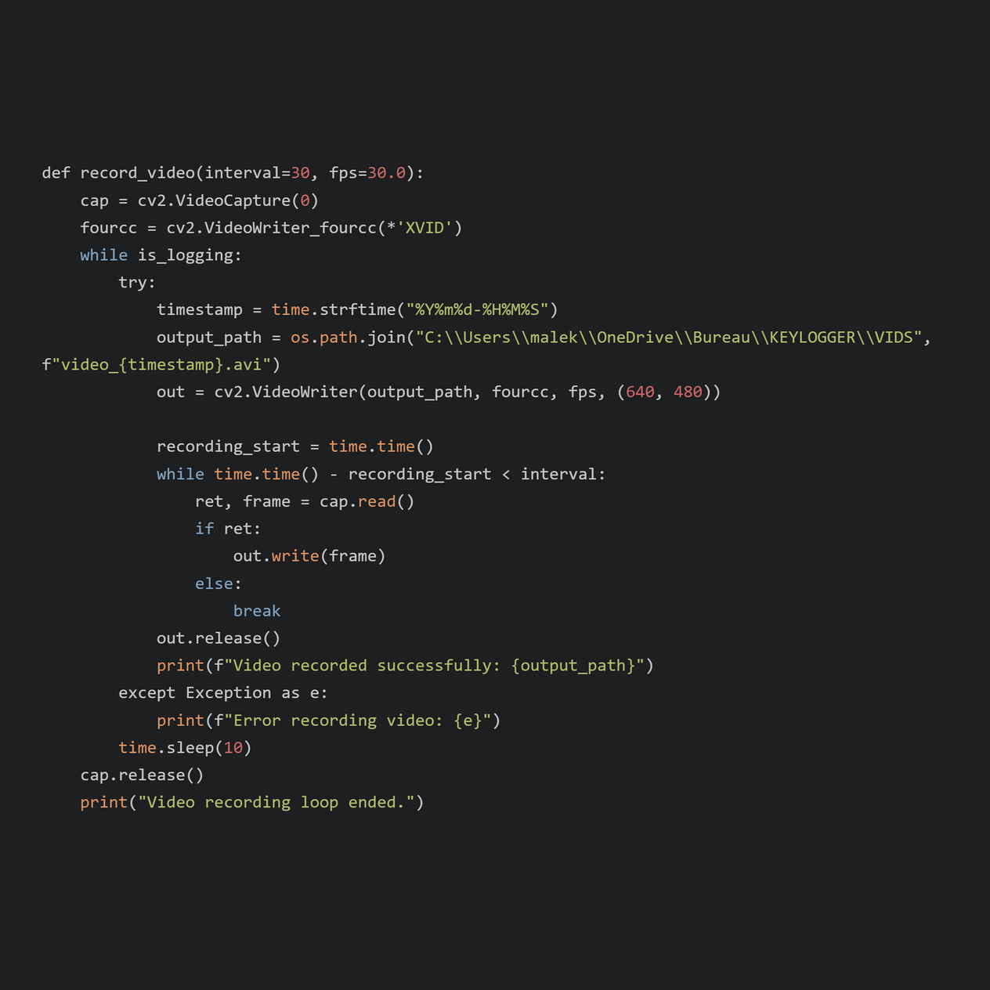
The record_video function continuously records video in chunks of the specified interval (default 30 seconds) and saves them to a specified directory as long as is_logging is True.
It handles errors gracefully by catching exceptions and printing error messages.
Each video recording is saved with a unique timestamped filename to avoid overwriting files.
The function ensures that resources (camera and video writer) are properly released when the loop ends.

Slide 20
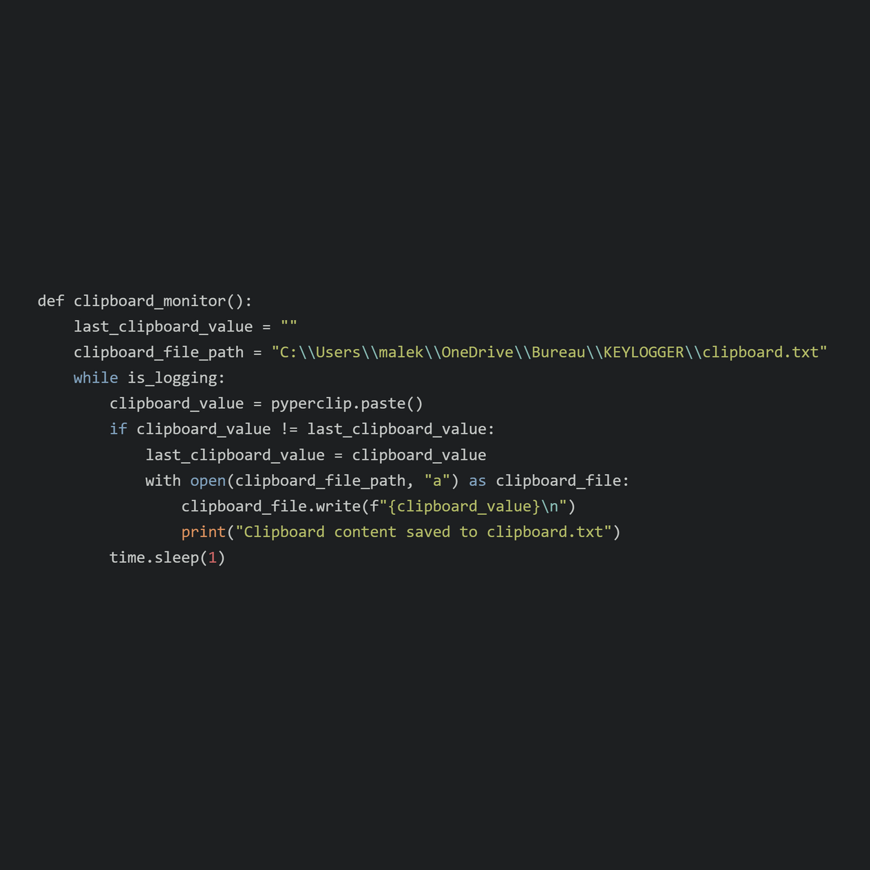
The clipboard_monitor function continuously checks the clipboard for changes and logs any new content to a specified file as long as is_logging is True.
It uses the pyperclip library to access the clipboard and logs changes by appending them to a text file.
The function ensures that clipboard changes are detected and logged promptly, with a check interval of 1 second.

Slide 21
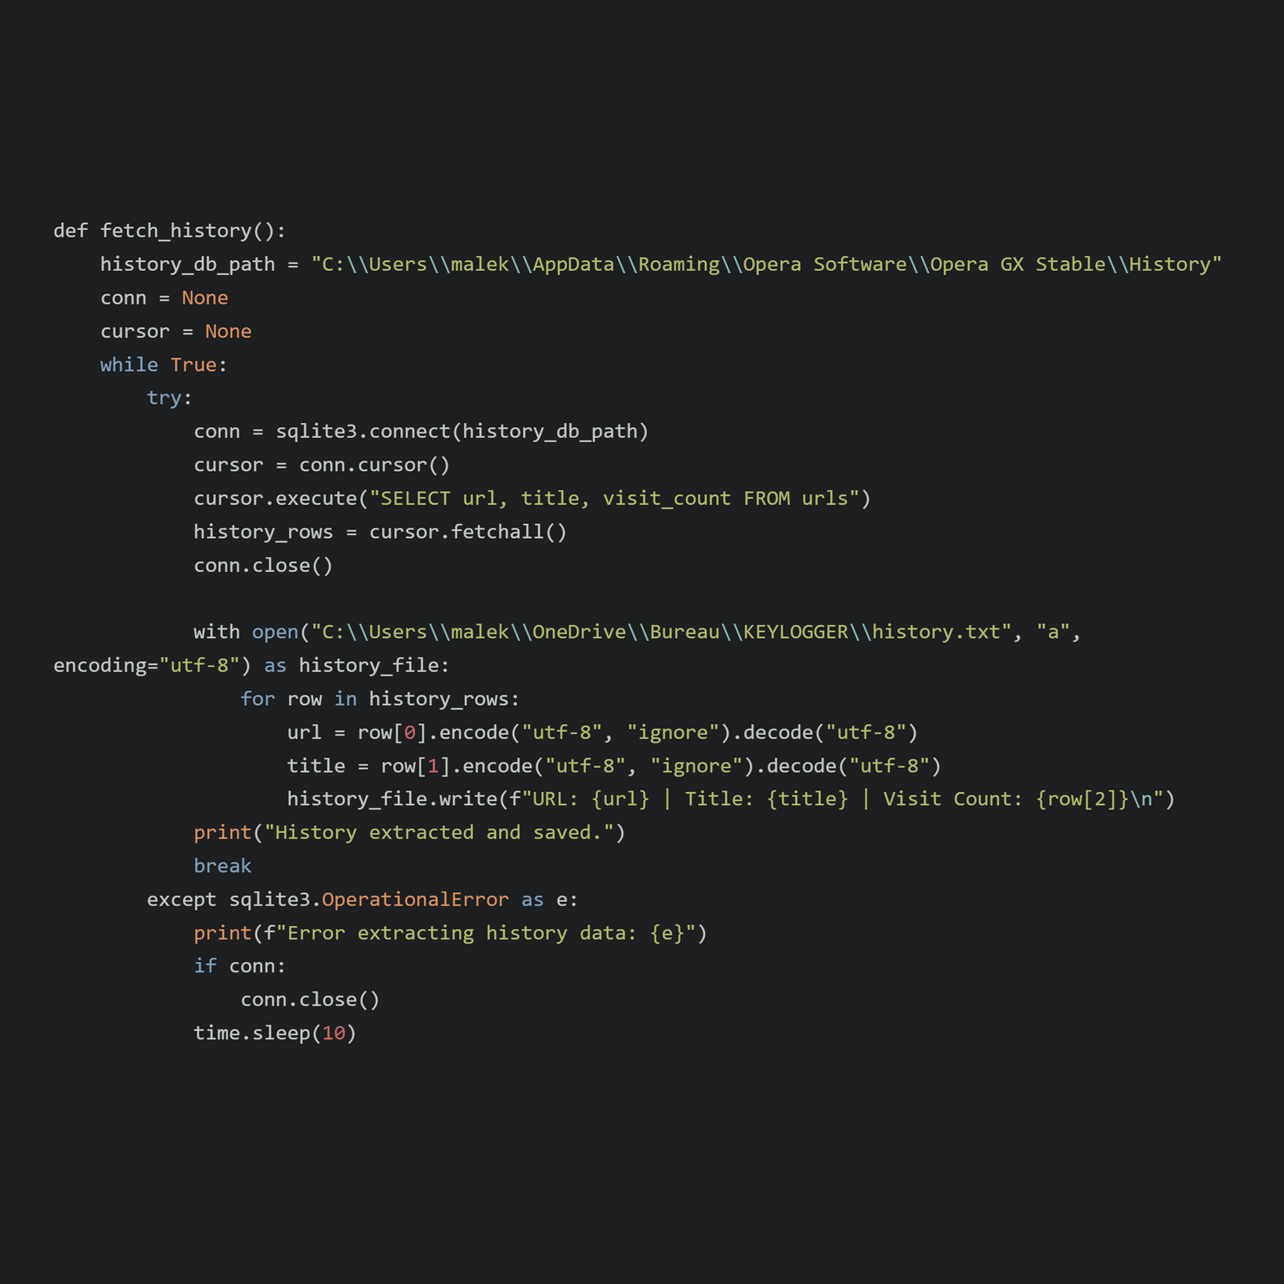
The fetch_history function attempts to extract browsing history from the specified Opera GX database and logs it to a text file.
It handles SQLite operational errors gracefully by retrying after a delay if an error occurs.
Each entry in the browsing history is written to the log file with its URL, title, and visit count.
The function ensures that the connection to the database is properly closed in case of an error.

Slide 22
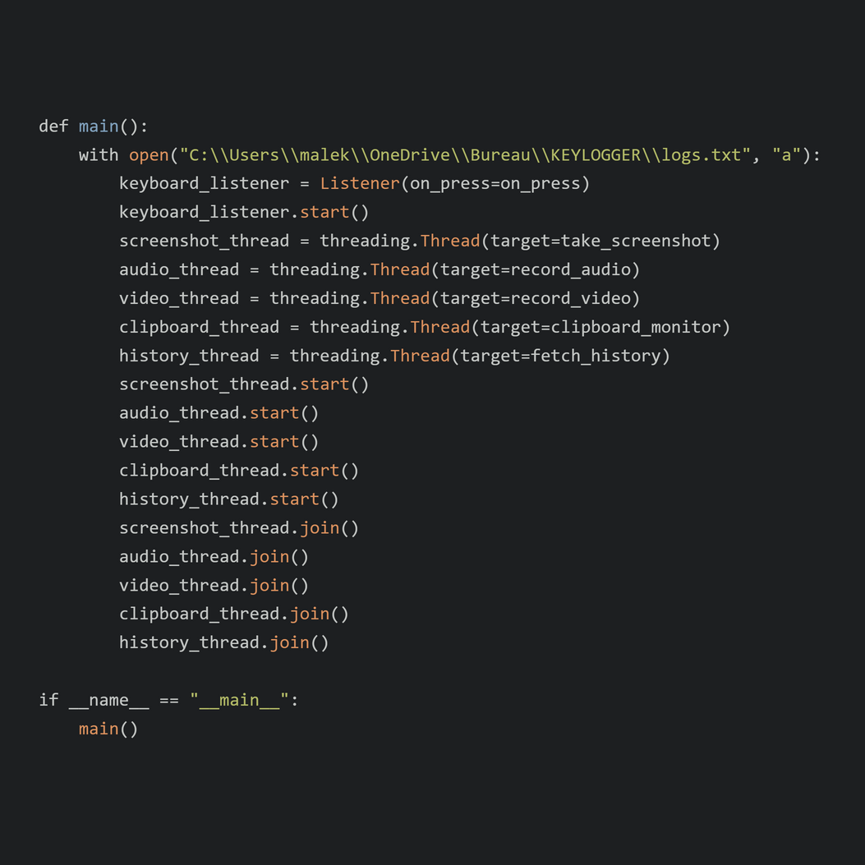
The main function initializes and starts several monitoring tasks (keyboard logging, screenshot taking, audio recording, video recording, clipboard monitoring, and fetching browser history) each in its own thread.
It waits for all these tasks to complete before exiting, ensuring all monitoring activities run concurrently.
The keyboard listener is managed by the pynput library, and the other tasks run in separate threads using the threading module.

Slide 23
LIBRARIES
OS: ENSURES DIRECTORIES FOR STORING LOGS, SCREENSHOTS, AUDIO RECORDINGS, AND VIDEO RECORDINGS EXIST, AND HANDLES FILE PATHS.
PYNPUT: LISTENS TO AND LOGS KEYBOARD EVENTS.
PIL (PILLOW): CAPTURES AND SAVES SCREENSHOTS AT REGULAR INTERVALS.
TIME: MANAGES TIMESTAMPS FOR FILENAMES, MEASURES INTERVALS FOR SCREENSHOTS AND RECORDINGS, AND INTRODUCES DELAYS BETWEEN ACTIONS.
SOUNDDEVICE: RECORDS AUDIO FROM THE MICROPHONE AT REGULAR INTERVALS.

Slide 24
LIBRARIES
SCIPY.IO.WAVFILE: SAVES THE RECORDED AUDIO TO WAV FILES.
CV2 (OPENCV): CAPTURES VIDEO FROM THE WEBCAM AND SAVES IT TO AVI FILES.
PYPERCLIP: MONITORS AND LOGS CHANGES TO THE CLIPBOARD CONTENT.
THREADING: RUNS EACH MONITORING TASK (KEYBOARD LOGGING, SCREENSHOT CAPTURE, AUDIO RECORDING, VIDEO RECORDING, CLIPBOARD MONITORING, AND BROWSER HISTORY FETCHING) IN ITS OWN THREAD FOR CONCURRENT EXECUTION.
SQLITE3: FETCHES AND LOGS THE BROWSER HISTORY FROM THE SQLITE DATABASE USED BY OPERA GX.

Slide 25
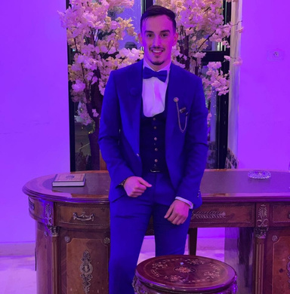

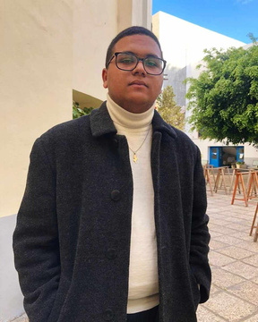

Meet
the Team
MALEK BEN HAMED
ISLEM JERIDI
ZAKARIA AYADI
MARIEM REJEB

Slide 26

THANK YOU FOR YOUR ATTENTION

